Slide 1
Some way Cool things to do in office 365 & azure
NEW AITP Meeting
September 19, 2017

Slide 2

Mike Nelson @nelmedia nelmedia@gmail.com
Cloud Architect – Zerto
Microsoft MVP – Cloud & Datacenter
Microsoft Azure Advisor
Citrix CTP
VMware vExpert

Slide 3
Discussions and Demos
Room Temp on Office 365 & Azure
Some Stats
Common Integration
The Live Stuff

Slide 4


Slide 5


Slide 6
Office 365
55m Users - <100m by Q1 2018
>250 new *features since EOY 2016
Thousands of *fixes
~6 new major app offerings 2016-2017
Consumer subscriptions down from 2016
Updates almost every month
Notes:
1.2 billion Office users
1 in 4 Enterprise users use O365
Microsoft 365 – mobility, Office, security

Slide 7
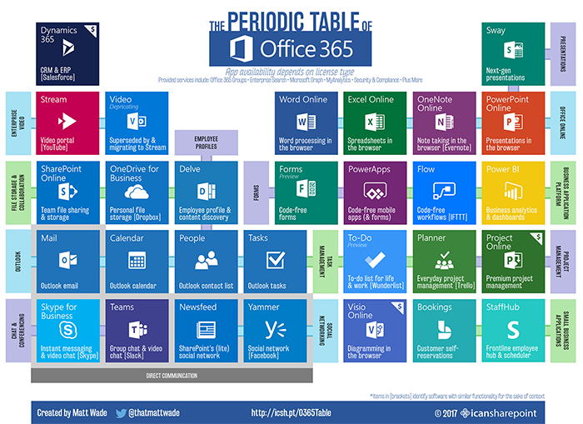

Slide 8
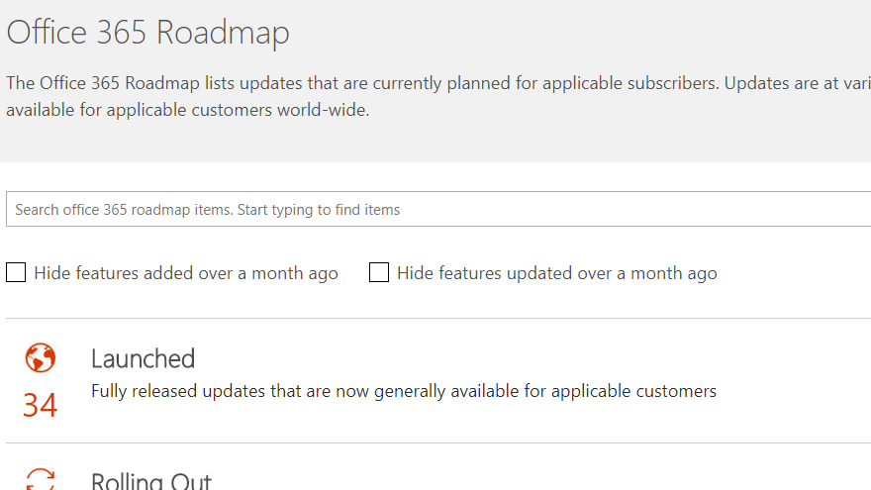
products.office.com/en-us/business/office-365-roadmap

Slide 9
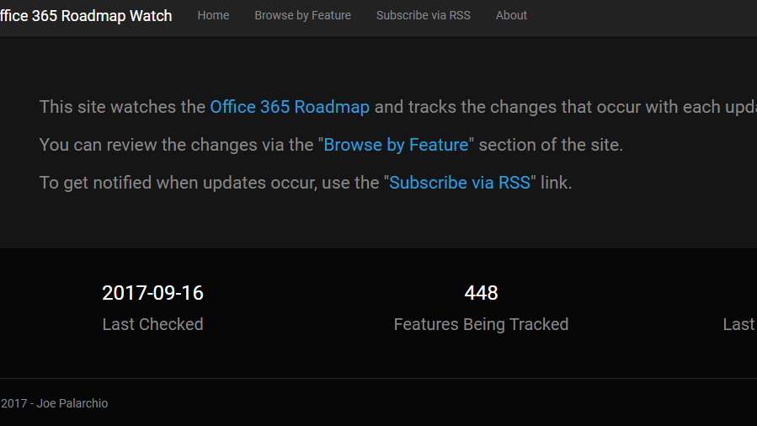
www.roadmapwatch.com

Slide 10
Azure
24-month growth is largest ever for a MS product
Product and feature matrix changes monthly
Now the largest public cloud provider
40 regions
120k new subscriptions every month
715m Azure AD accounts

Slide 11
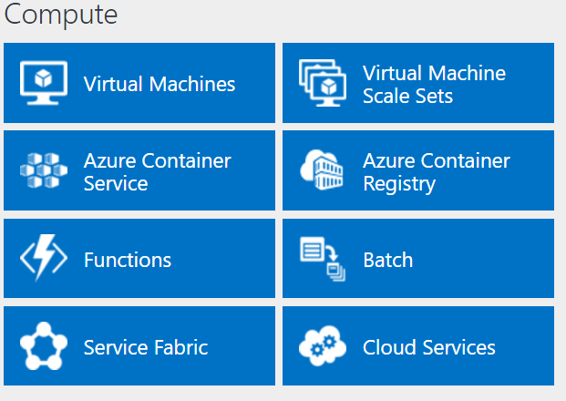
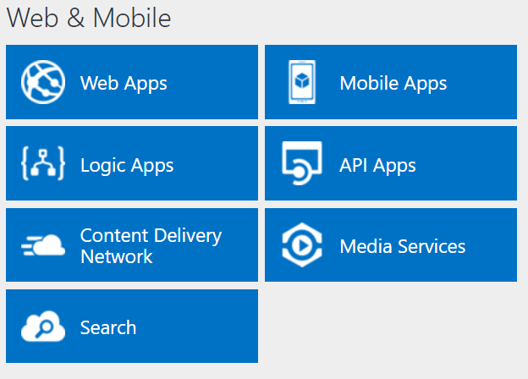
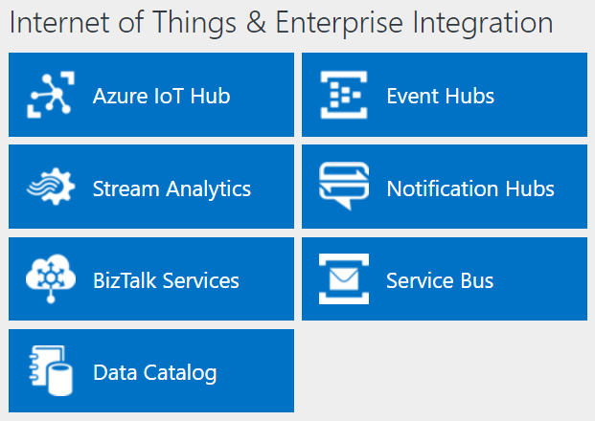
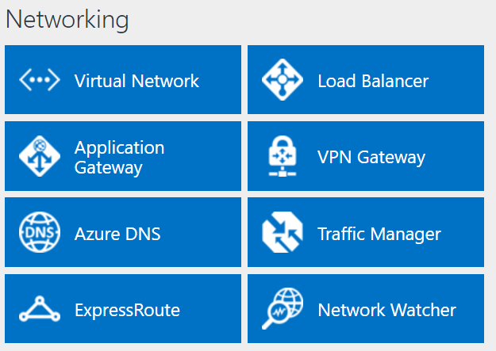
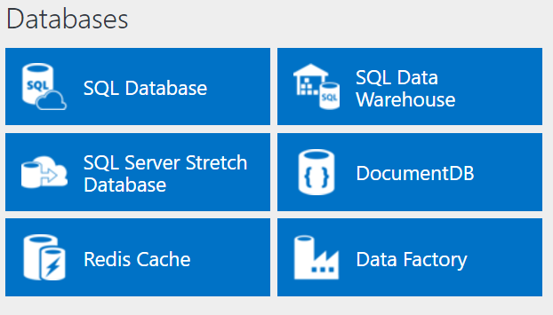
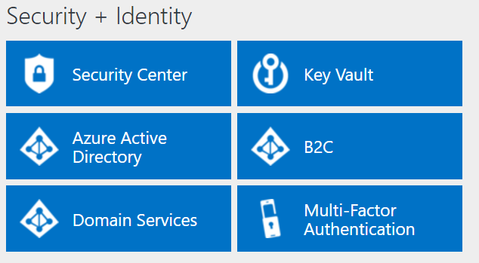
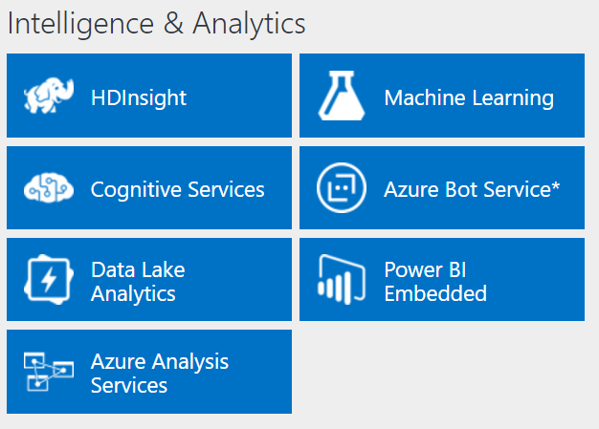
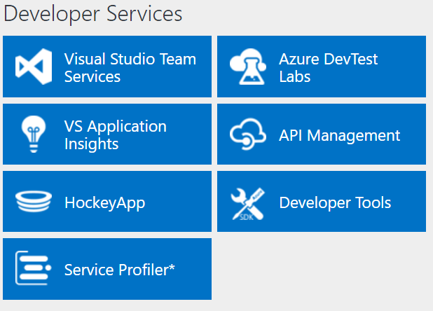
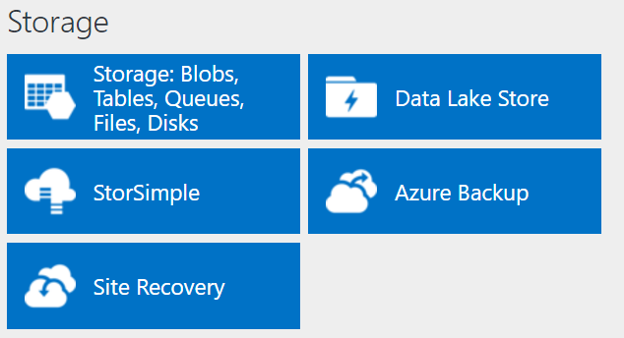
http://azureplatform.azurewebsites.net/
* Preview Services
Notes:
Preview Version 1.7 (2017-04-20)

Slide 12
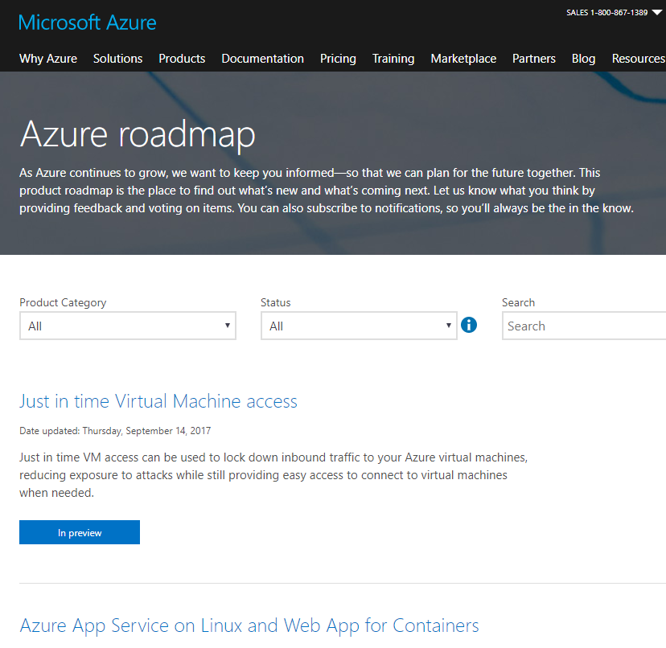
azure.microsoft.com/en-us/roadmap

Slide 13

Integrations
Identity Management
Azure Active Directory
Domain Controller as a Service
Multi-Factor Authentication
Security and authentication across devices and platforms
IaaS, SaaS, PaaS, DaaS, and DRaaS

Slide 14

Notes:
Reliability and speed

Slide 15
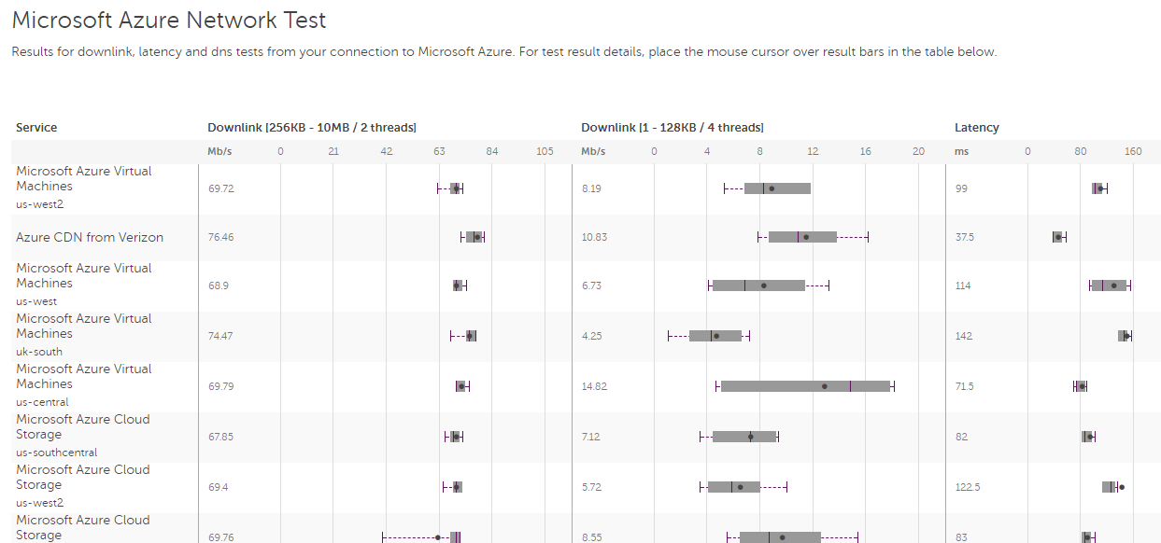
Azurespeed – www.azurespeed.com
Azure Speed test – azurespeedtest.azurewebsites.net
CloudHarmony – www.cloudharmony.com/speedtest-for-azure
FT Network Analysis – na1-fasttrack.cloudapp.net/o365nwtest

Slide 16


Slide 17
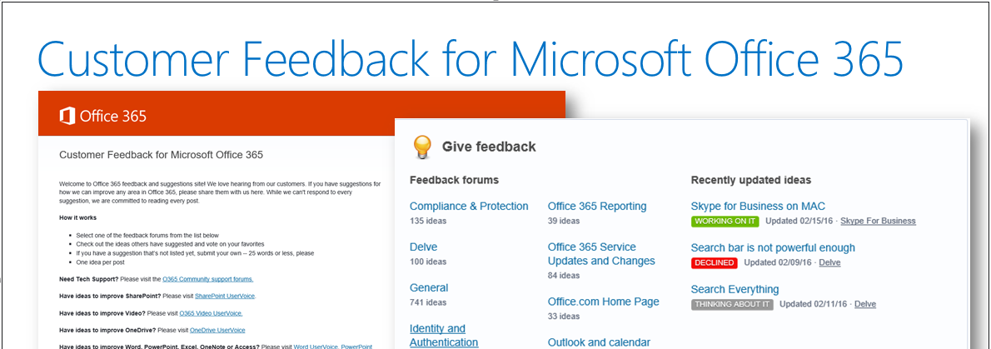
Office365.Uservoice.com
Feedback.azure.com
Windows feedback tool

Slide 18
The live stuff

